Slide 1
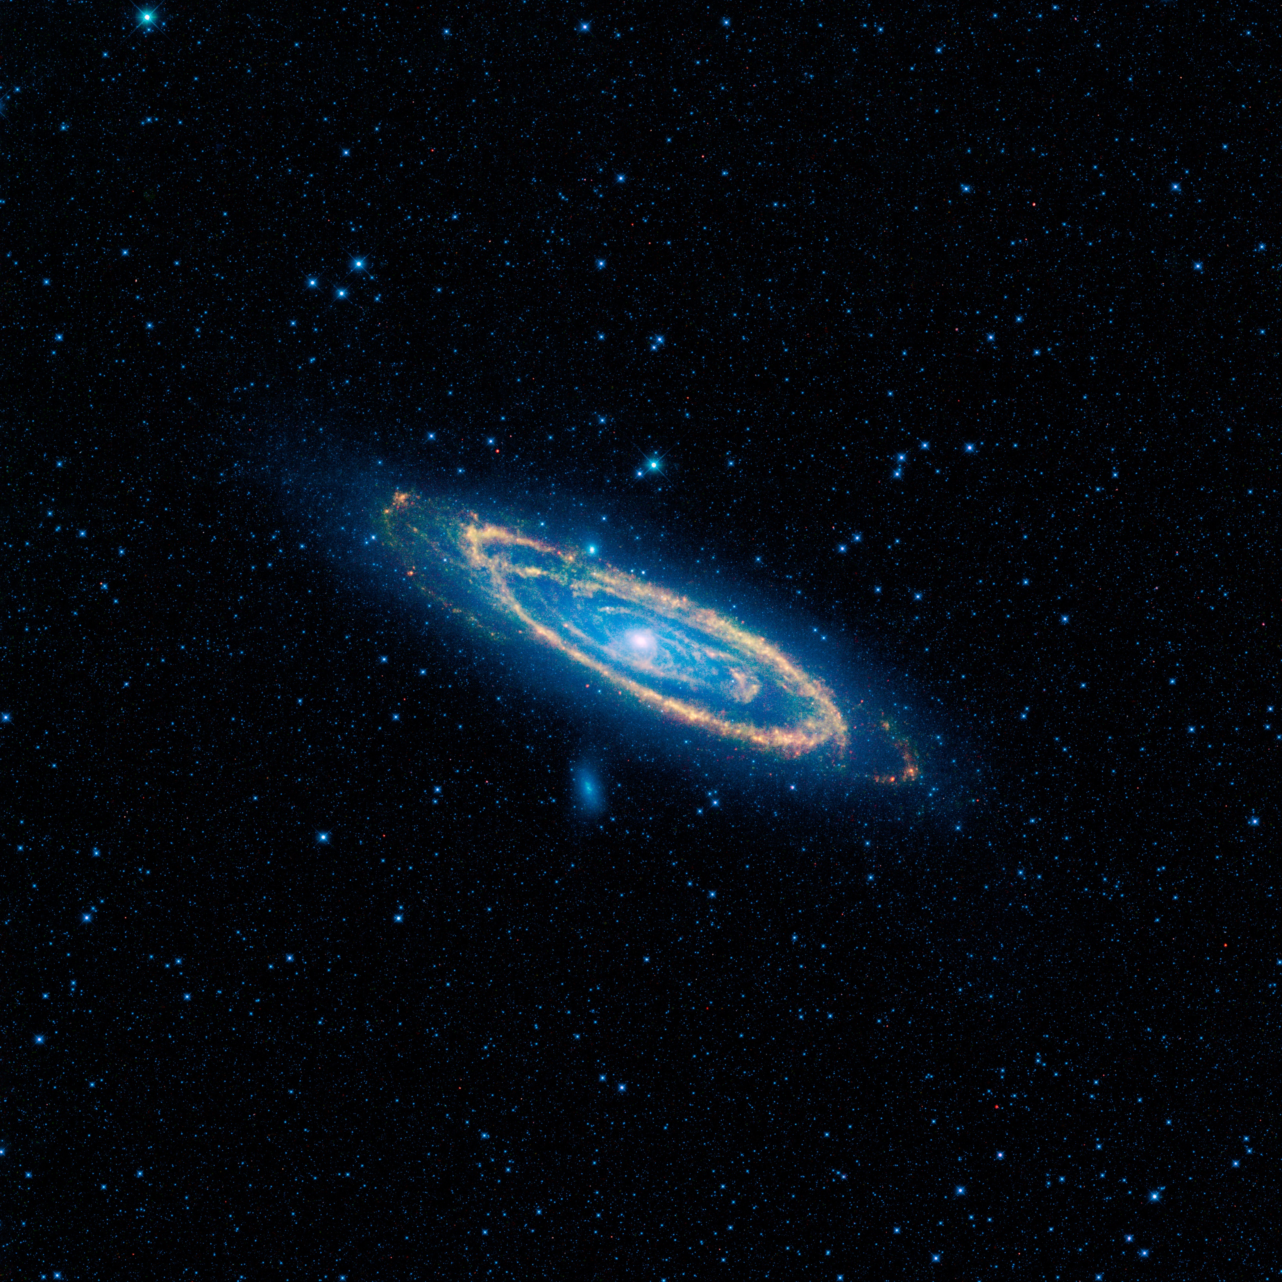
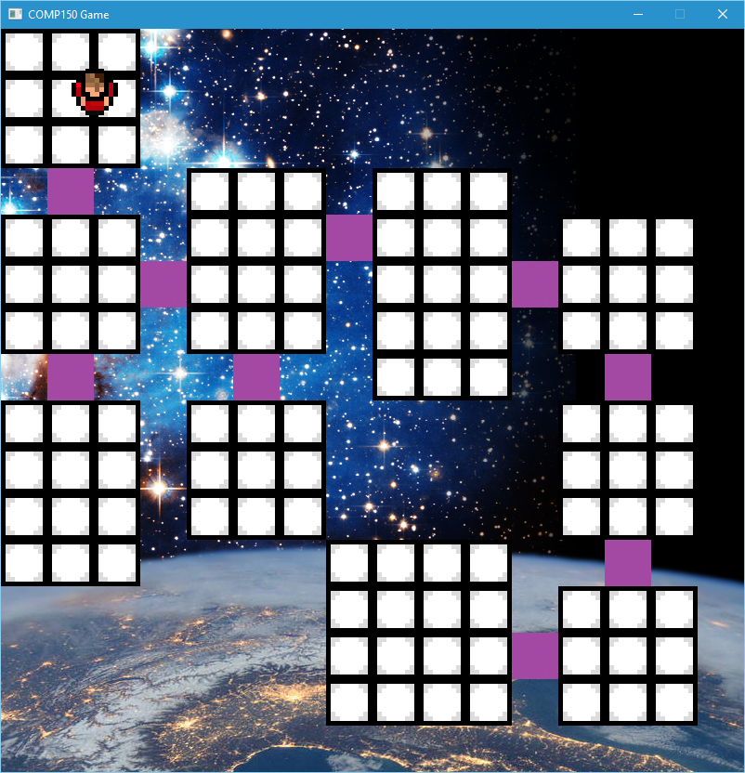
Character AI & Updating Background
Text – Intro
Character AI – character can be in different states
Background API – background updates depending on ISS
About API
Code snippet
AI Image
About AI

